Slide 1
Restructuring Housing Markets to the “Promised” Land
(Feedom to Freedom)
Timestamp 126:40
▶ 5/17/22 TPC Presents The Solutions show | Spreaker
Land (Claim and Title) Law | Contents (archive.org)

Slide 2
Fundamental Natural Rights Served by Home
Ius Naturale Vitam = to Life
Ius Naturale Vivus = to possession and ownership of one's own body
Ius Naturale Proprius = to one’s own character, identity and name
Ius Naturale Nutrimens = to food and sustenance
Ius Naturale Tectum = to shelter
Ius Naturale Salutis = to safety and well being
Ius Naturale Connubi = to union (matrimony, family, and community)
Ius Naturale Usus = of use
Ius Naturale Usurae = to fruits (enjoyment) of use
Ius Naturale Fructibus = to fruits, energy, results of one’s own work

Slide 3


The Transaction
Grants Title to Land – “Legal Permit”
permit – “allow to be done”
Trust
Provide Improvements – “Profitable Use”
profit – “benefit”
Everything Belongs to The Earth
We are Granted the Right-of-Use (Ownership) and
Responsibility to Improve The Earth As Guardians

Slide 4
Why Profits?
Provides Growth
But for Whom?
Balance Needs of Individual and Collective
Adult Responsibility to Care and Share

Slide 5
The Trust
Financial Purpose
Oversee Earth’s Resources by holding Legal (Right of Ownership) Title
Facilitate Investment in Improvements
Insure Catastrophe
Trust

Slide 6
Every Decision Is An Investment
Action | Investment In
Buy Groceries | Meals
Learn | Knowledge
Travel | Experience
Spend on Home | Roots, Privacy and Security
Give | Regive / Receive
Save | Growth
Investment as and energy flow means “to clothe (with attributes) the mind”

Slide 7
Mortgage
Grants immovable property (realty) as security for money lent or contracted to be paid
A Dead Pledge
  Doubtful Feoffer (man or woman who grants the feoffment – fee), borrower, mortgagor or tenant will pay at the day the required sum. If not, then the land and dwellings pledged upon condition of payment is take forever and dead to him/her upon condition
  If all payments made, then the pledge is dead to the tenant
The Deed (“that which is done, acted, or performed”) supports the Mortgage through a Covenant, which is legally a “promise made by deed”
Entering a Covenant is also entering an Indenture

Slide 8
Trust Note (Right of Title)
Trust refers to The Trust, but also, “rely on, make strong or safe”
Note “sets it down in writing” and “observes, mark carefully”
Note is currently a financial instrument, without the deleterious etymology of bonds or mortgages.
Our Word is Our Bond, not some security bonding us

Slide 9
Term Sheet of Mortgage System Example
Average Market Price of Home | $350,000
Less: Down Payment (10%) | 35,000
30 Year Mortgage Initial Balance | $315,000
Interest Rate (Compound Monthly) | 4.5%
Monthly Payment | $1,596.06

Slide 10
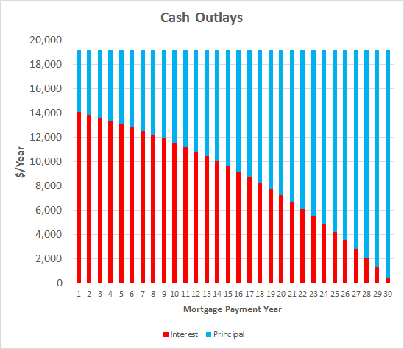
Existing System: 315k Mortgage – 4.5% IR
Principle = Equity = Illiquid Savings Available only through Sale
Costs $259.6k in interest to save $315.0k of At-Risk Equity
$19,152.7 per year

Slide 11
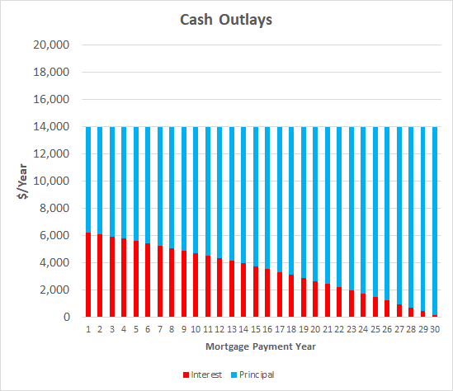
What If: 315k Mortgage – 2.0% IR
Payment reduced by 27% or $5,181.1 per year
$13,971.6 per year

Slide 12
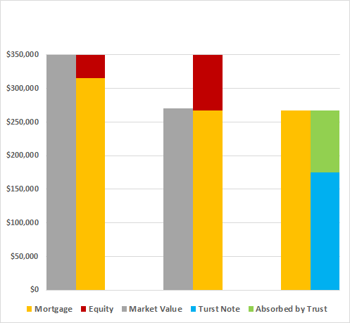
Year 8: Refinance 4.5% Mortgage to 2.0% Trust Note
Equity at Risk to Market Price fluctuations
Year 8, assuming Market Price drops to 270K, all equity potentially lost
Refinance to Trust Note year-end 8,
  Trust transacts Value of house to 175k, the replacement value, which is the amount borrowed by homeowner
  Trust pays the bank $267,173.70, the remaining principal outstanding, to clear the original Mortgage
Mortgage
At Initial Close
Mortgage
End Year 8
Refinance to Trust Note

Slide 13
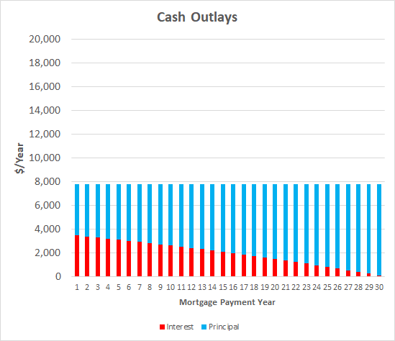
Payment Schedule: 175k Trust Note – 2.0% IR
Reduction in annual payments frees funds for other pursuits
Do we need to restrict bigger home
  What about large nuclear families?
$7,762.01 per year

Slide 14
Reduction of Cash Flow From Trust Note
Reduced service of debt by 60%
Reduces Equity – at risk
Free $11,390.69/year for other desires
  Liquid Savings for retirement, self insurance
  Home Appurtenances
    Indoor and Outdoor
  Home Maintenance
  Experiences – Travel, Learning
  Other

Slide 15
Additional Borrower Rights
Event of loss of income:
  Trust Note Service can drop to interest payment only
  Provide time to restructure – promote cooperation and reduce fear
Borrower has a “put” option – is the right, but not the obligation, to sell the property to the Trust at Replacement net outstanding Principle of Trust Note and required major maintenance

Slide 16
Bank Restructuring – Likely Needed
Bank
Serve Owners
Savings and Checking Accounts are unsecured creditors – at risk to bankruptcy (harvesting event)
Competes via loan terms
  Interest rates
  Credit score
Trust Backed Institution
Protect Savings And Checking
Supply working capital to businesses of Savers
Secured by Trust – bankruptcy is completely avoidable
Offer Note services
  Fairly pricing replacement costs
  Fairly assess degradation of house
  Title and Sovereign Services services

Slide 17
Market Penetration
Mortgages at Risk to Foreclosure / Delinquency
Refinancing of all Homes
New Home Ownership
Model of Apartments and Condos
Financing Homes for Homeless
Development in Developing World
No to people moving to larger homes – need higher coverage rate
Encourage smaller home with larger plot of land

Slide 18
What Next
Research Law – definition of land and determine how to remove their claims
Explore Registry System? Ucadia?
Begin drafting of Business Plan – first outline issues

